Slide 1
EASTERN NATIONAL
UNIFORM PROGRAM

Slide 2
HIGHLIGHTS
WEB BASED PROGRAM
MORE UNIFORM COLORS TO CHOOSE FROM
SIMPLE TO USE
2 WEEK TURNAROUND TIME
NO FORMS UNLESS THERE IS A PAYROLL DEDUCTION

Slide 3
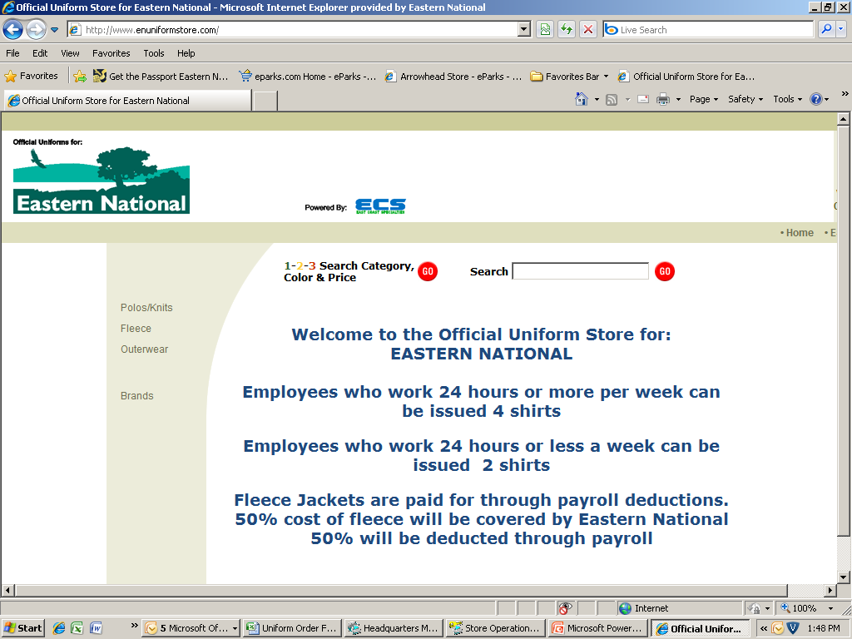
www.enuniformstore.com
Click on the type of uniform you are interested in ordering.

Slide 4
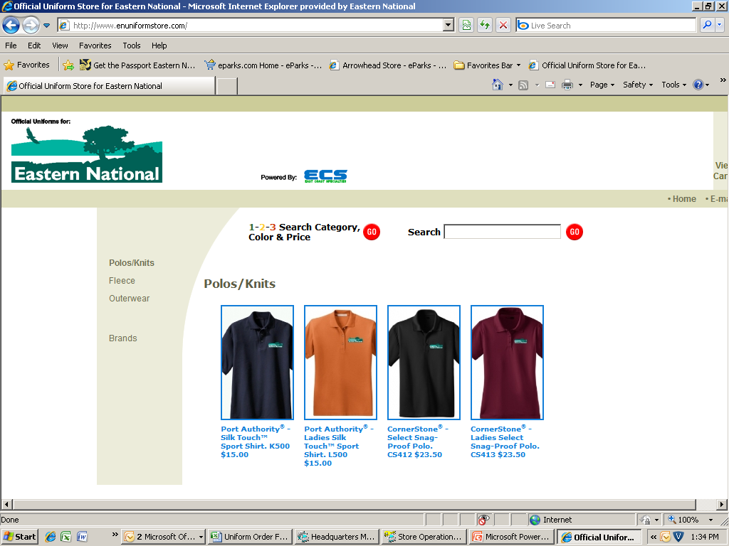
Click on the style you are interested in ordering

Slide 5
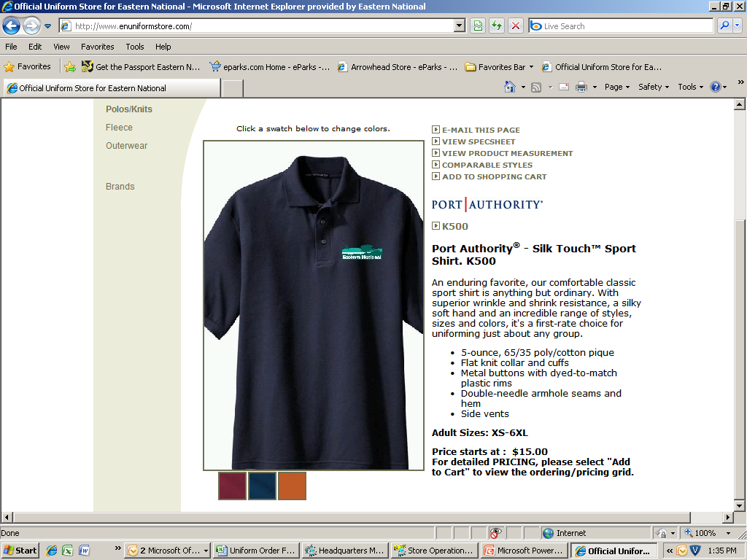
Click on “ADD TO SHOPPING CART”

Slide 6
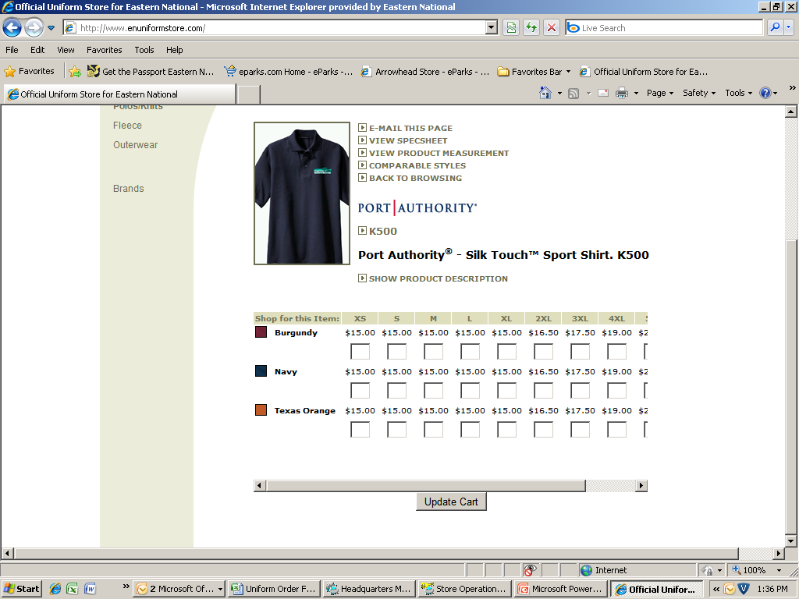
Fill in the amount of shirts that you require to order. ONE COLOR PER STORE!
Click on update cart

Slide 7
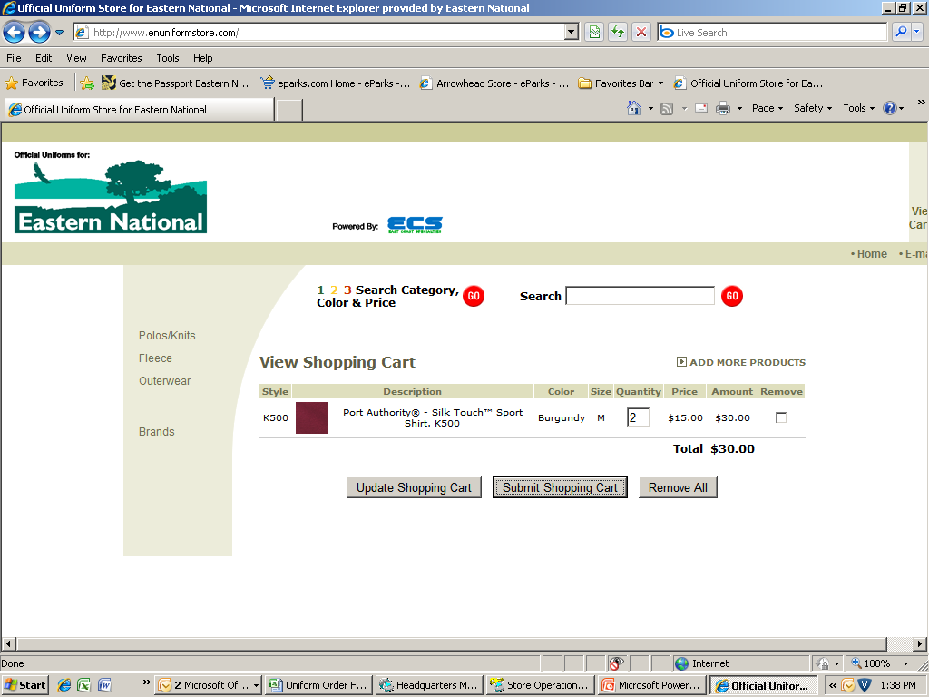
Click on Submit Shopping Cart

Slide 8
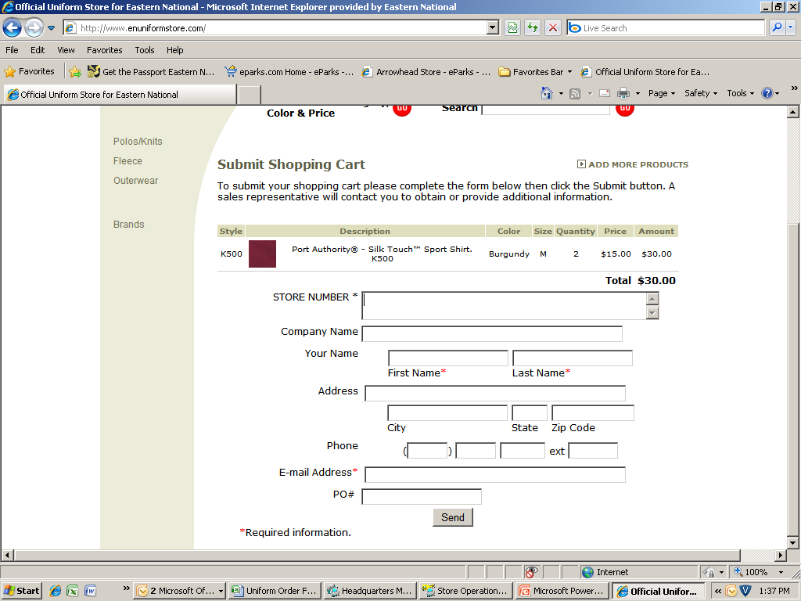
Insert ALL information for shipping location
Contact name at store
RM’s Email

Slide 9
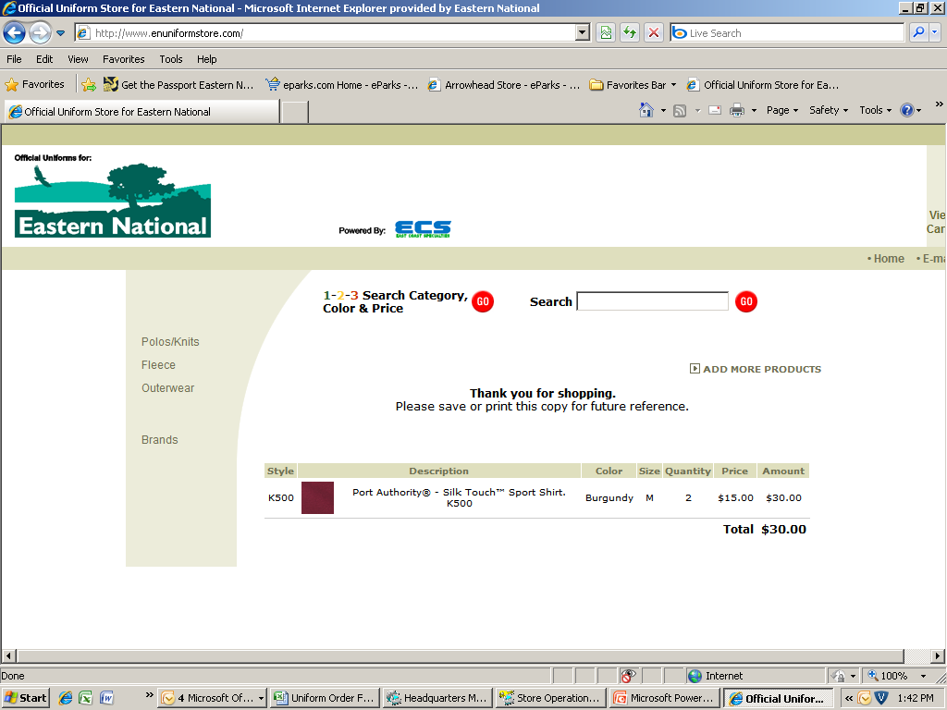
Order Confirmation

Slide 10
Email confirmation for your records
STORE NUMBER *
915
Company Name: Eastern National
Customer Name: Mark Vineburg
Address: 470 Maryland Drive, Suite 1
Fort Washington, PA
19034
Telephone: (215) 283-6900 ext. x123
E-mail Address: markvineburg@easternnational.org
PO#: Test
Style Description Color Size Quantity Price
K500 Port Authority - Silk Touch Burgundy M 2 $15.00
Sport Shirt. K500
TOTAL $30.00
Order reference number: 7710204

Slide 11
RETURNS:
If you receive an incorrect size or have an issue
with your shirts, please do the following:
Return the shirts to the vendor using the information provided on the packing slip.
Email the vendor with a copy to Bill Thomas to explain the reason for the return:
markb@ecspecialties.com;
billthomas@easternnational.org

Slide 12
A FEW NOTES:
Orders are to be placed by Regional Managers.
All employees need to wear the same colored shirts per store.
Please order for the whole store all at once. For new hires, order when hired.
If there is a payroll deduction, please fax the uniform order form to Bill Thomas in the payroll. Otherwise there is no need to send in an order form.
Eastern National will split the cost of the fleece jackets 50/50 with the employee.

